Slide 1
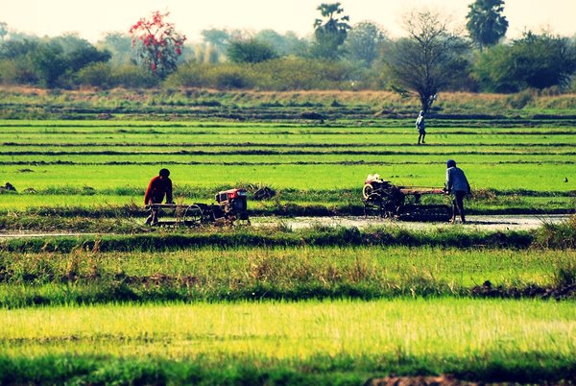
Non-farm Occupational and Earnings Dynamics in Rural Thailand
March 7th, 2013
Applied Microeconomics Seminar, Monash University
Chayanee Chawanote and Christopher B. Barrett
Cornell University

Slide 2
Motivation
The transition from agriculture to rural non-farm work is natural with economic development and population growth.
Because those in highly productive non-farm activities enjoy upward earnings mobility (Barrett, Reardon and Webb, 2001; Block and Webb, 2001; Lanjouw, 2001), gov’ts and donors increasingly promote RNFE self-employment for rural poverty reduction.
But the entrepreneurship literature also emphasizes the difficulty of firm expansion (Fafchamps 1994, Haggblade et al. 2007, de Mel et.al., 2008; Schoar, 2009). Most self-employment has no paid non-family workers and failure rates for those with employees are very high.
Introduction & Motivation Data & Definitions Methods & Results Conclusion

Slide 3
Motivation
But the empirical literature on RNFE
relies heavily on (repeated) cross-sectional evidence. Only panel studies are not nationally representative (and only on Ethiopia).
fails to distinguish between self-employment w/ and w/o employees, thereby conflating ‘subsistence’ and ‘transformational’ enterpreneurs
largely ignores the interplay between “the distribution of income and wealth” and the dynamics of occupational choice” (Banerjee and Newman, 1993) and even less rarely addresses the prospective selection effects that conflate causal inference about the earnings effects of occupational transitions in rural areas
Literature on occupational transitions and conditional earnings mobility (Cichello et al., 2005; Woolard and Klasen, 2005; and Fields et al., 2005) fails to address the rural farm-nonfarm transition .
Introduction & Motivation Data & Definitions Methods & Results Conclusion

Slide 4
Research questions/contributions
What patterns of occupational transitions exist among farmers, non-farm employees, non-farm self-employed, and non-farm employers in rural Thailand ?
How do occupational transitions associate with directional earnings mobility? Does movement out of farming boost individual earnings, controlling for selection into occupations? Are all transitions into RNF equally desirable?
What causes these rural occupational transitions?
First use of the Thai SES since it became a panel. Introduce data and do necessary attrition analyses.
With four rounds over five years, we can use more robust methods to more confidently identify the effects of rural occupational transitions on earnings.
Introduction & Motivation Data & Definitions Methods & Results Conclusion

Slide 5
Outline
Data and background
Definition of rural non-farm employment
Occupational transitions
Effects of occupational transitions on earnings
Determinants of occupational shifts
Conclusions
Introduction & Motivation Data & Definitions Methods & Results Conclusion

Slide 6
Data
Thai Socio-Economic Survey (SES) panel data: 2005 – 2007, 2010
Household section: Information of HH members, HH characteristics and assets, income from agriculture
Members age 15+ section: Education, health care, employment, incomes, expenditures, financial status (debt & savings), migration
Initial survey: 6,000 households, 16,310 individuals (9,897 in rural)
Sample in 4 waves : 7,831 individuals in rural areas
4,090 individuals employed and aged between 15-70 years
Correct for attrition weights in all regression analyses
Supplement with National Rural Development (NRD) village-level survey: 2005, 2007, 2009
General conditions and infrastructure of village, economic conditions, education and health
Introduction & Motivation Data & Definitions Methods & Results Conclusion

Slide 7
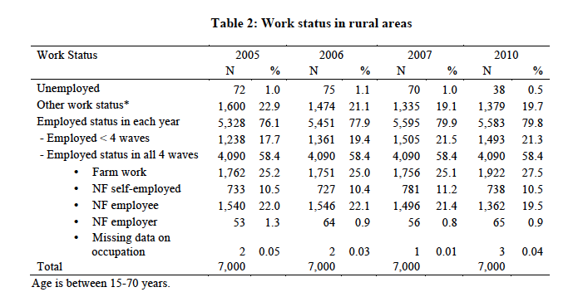
Definition of rural non-farm employment
Farmers: primary employment in agriculture, livestock, fishing and hunting
Non-farm employers: own business and hire employees
Non-farm self-employment: own business without paid employees
Non-farm employees: wage or salary workers outside of agriculture
Introduction & Motivation Data & Definitions Methods & Results Conclusion
Notes:
Other categories in the survey are waiting for seasonal work, looking for work, retired, long term illness and disabilities, caring for other household members, and going to school.

Slide 8
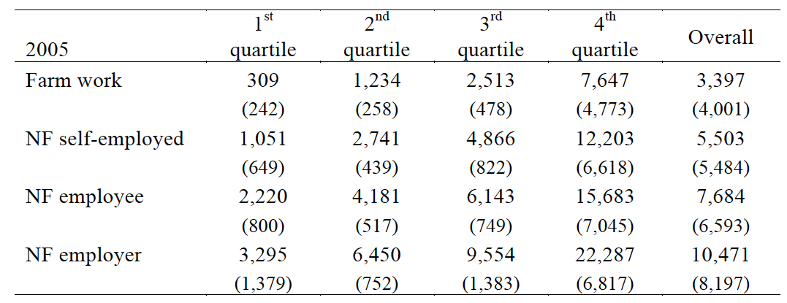
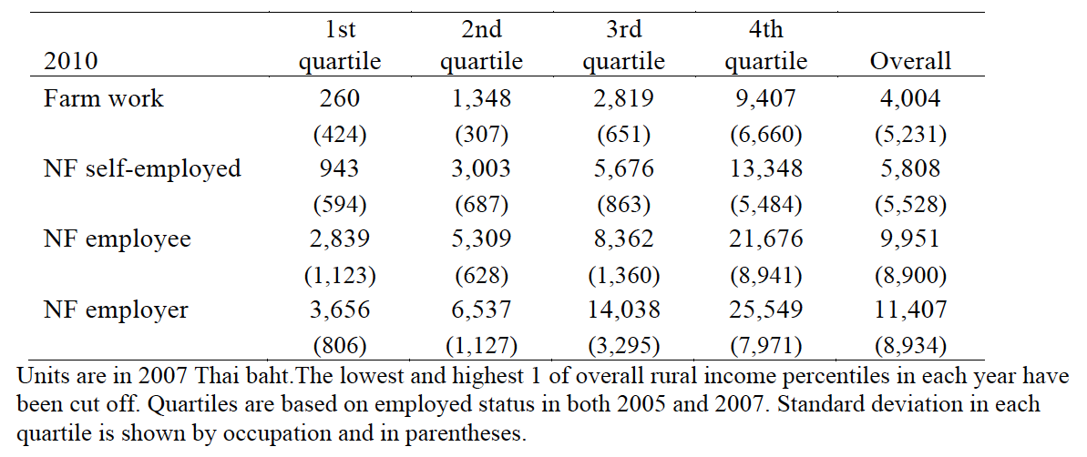
Mean monthly earnings by quartiles and occupation
Introduction & Motivation Data & Definitions Methods & Results Conclusion
Notes:
Summarize from Table 3 in the paper
individual earnings are calculated based on a share of labor time allocation within the household (hours per week).
Given that the rural poverty line in 2007 was 1,333 baht10 per capita per month, individuals, except farmers, in the first quantiles on average emerge above the poverty line. 20 percent of employed status workers in rural areas emerge as under the poverty line and almost 80
percent of this group are farmers. However, this is based solely on these three sources of incomes, excluding incomes from other sources such as remittances, incomes from house/land lending, or returns from financial assets.

Slide 9
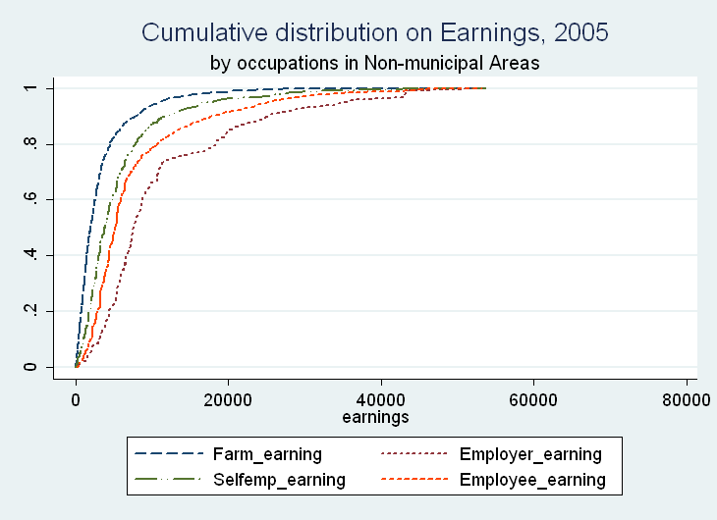
Ordering of earnings in rural Thailand
All RNFE occupations’ earnings distributions first degree stochastically dominate farming.
NF employer’s and employee’s earnings distribution also first-order stochastically dominate NF self-employment’s
The most lucrative occupation, on average, is non-farm employer followed by non-farm employee, non-farm self-employment, and, last, farming.
These patterns are replicated in the 2006, 2007 and 2010 data as well.
Introduction & Motivation Data & Definitions Methods & Results Conclusion

Slide 10
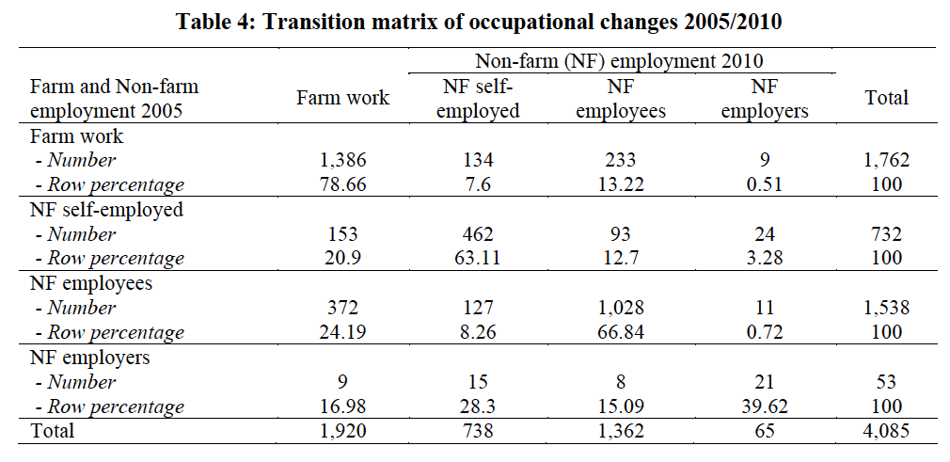
Patterns of occupational transitions
Occupational transition matrix 2005/2010
Introduction & Motivation Data & Definitions Methods & Results Conclusion
Notes:
Most people remain in their occupation over the three year period. But more non-farm employers converted to merely self-employed than maintain their status. It is tough to maintain a rural non-farm business with employees.
Other transitions mainly moved into non-farm employment rather than into non-farm self-employed or employers.
Those who did not change occupation enjoyed positive median earnings changes, except those who remained farmers.
Moves into the RNFE generally yielded earnings gains while moves into farming typically brought earnings losses

Slide 11
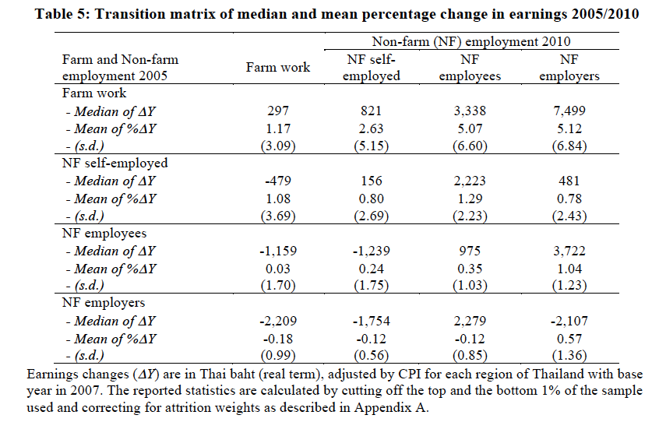
Patterns of occupational transitions
Introduction & Motivation Data & Definitions Methods & Results Conclusion

Slide 12
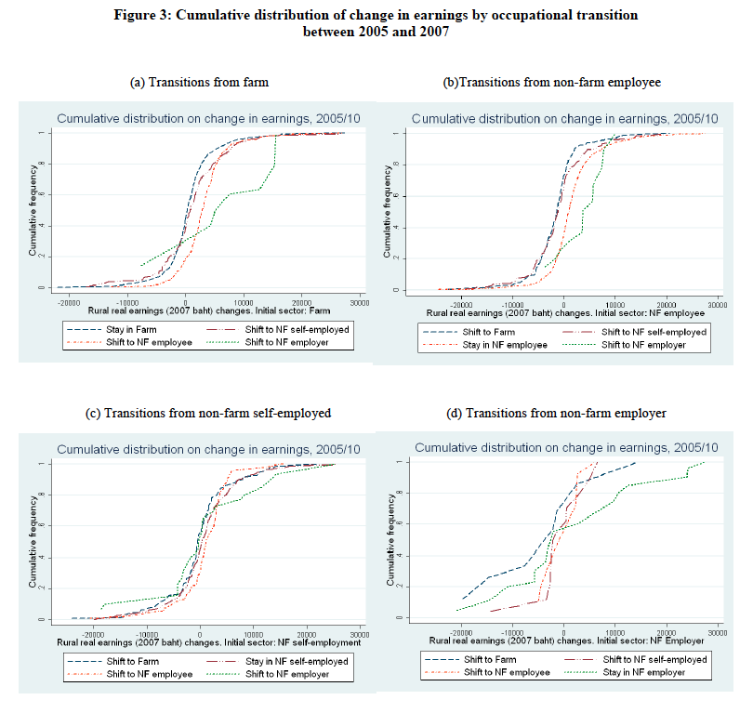
Notes:
Initial farm: NF > farm
Stochastic dominance: employer, employee > the rest, self-employment > farm

Slide 13
Multivariate estimation methodology
Conditional mobility models explore how earnings changes associate with farm and non-farm occupational shifts. Following Fields(2007) & Cichello et al. (2005), the model is:
Δln y_{it} is the change in reported earnings.
y_{i,t-1} is previous year reported.
Z_{i} denotes time-invariant variables, observed individual and household characteristics, in the initial year.
ΔX_{it} denotes employment transition experiences – dummy variables for the 15 possible transitions – with staying in farm work as the reference case.
ϕ is individual (or sub-district) fixed effects. t is time effect and ε_{it} is a mean zero, heteskedasticity-corrected, i.i.d error term.
Introduction & Motivation Data & Definitions Methods & Results Conclusion

Slide 14
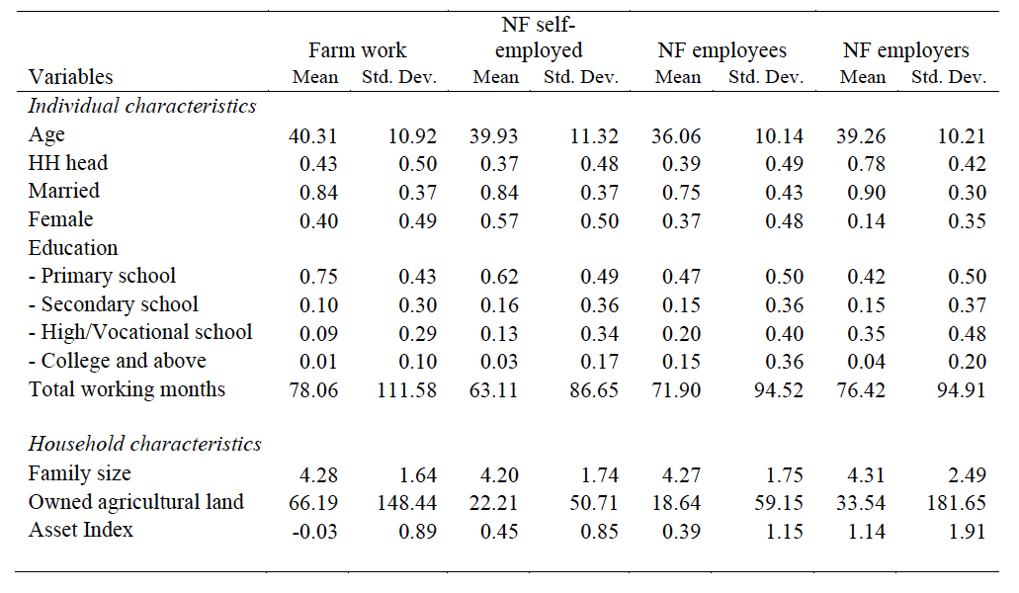
Conditional micro mobility models
Summary statistics across occupational groups
Introduction & Motivation Data & Definitions Methods & Results Conclusion

Slide 15
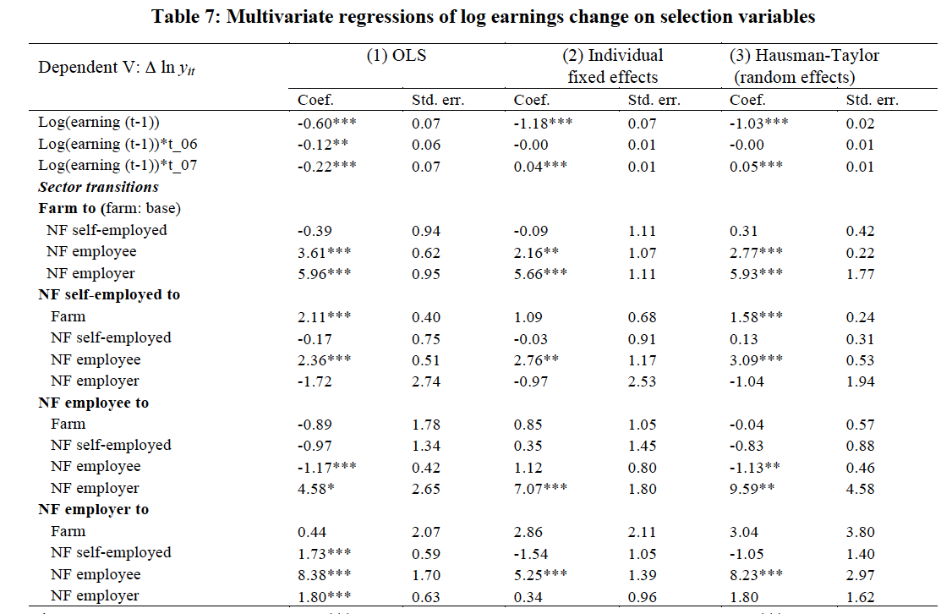
Introduction & Motivation Data & Definitions Methods & Results Conclusion
Notes:
Shifts into farming are associated with earnings losses, on average. By contrast, participation in the RNFE is associated with statistically significant earnings gains. The results are quite consistent with the unconditional earnings orderings in Figure 3.

Slide 16
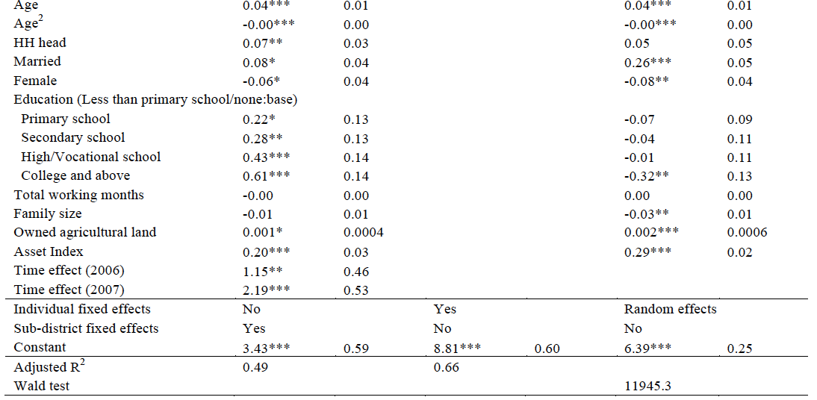
Conditional micro mobility models
Introduction & Motivation Data & Definitions Methods & Results Conclusion

Slide 17
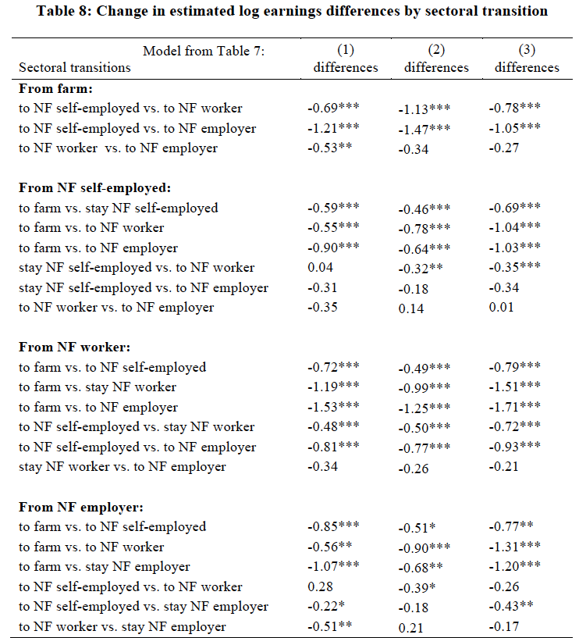
Introduction & Motivation Data & Definitions Methods & Results Conclusion

Slide 18
Robustness checks
Alternative models
i) IV with predicted probabilities of multinomial logit of occupational shifts in 1st stage
ii) Multinomial logit model correcting for selection bias, following Dubin and McFadden (1984) and Bourguignon et al. (2007)
Add 1st stage: determinants of occupational shifts
Introduction & Motivation Data & Definitions Methods & Results Conclusion

Slide 19
Determinants of occupational shifts
Changes in unobservables could be driving both changes in earnings and changes in occupation:
Control for changes in village-level environment & infrastructure
Reduce prospective problems of reverse causation, omitted unobserved productive factors and other confounding factors
Costs associated with changing sectors
Control for total months of working in current job & ratio of households working in particular sectors within the village
Estimate occupational transition probabilities using multinomial logit models, given initial occupation, in stage 1
Introduction & Motivation Data & Definitions Methods & Results Conclusion

Slide 20
Determinants of occupational shifts
An individual compared her expected utility under different occupations and her constrained conditions
ΔV refers to changes in community variables, such as infrastructure and agricultural circumstances.
Base category is staying in one’s initial occupation, m
The small number of observations of non-farm employers precludes estimation from that base position.
Introduction & Motivation Data & Definitions Methods & Results Conclusion

Slide 21
Main results from multinomial logit
Lower initial earnings are strongly associated with the occupational shifts. People switch when underperforming.
Greater initial asset holdings are associated with moving from farm to non-farm business owner, while fewer assets are associated with moving back to farm. However, agricultural land holding promotes transitions into farming.
Having insufficient water for farming increases shifts from farm to non-farm employment.
Transport infrastructure matters. Reduced travel time to the nearest district induces a shift from non-farm worker to farming.
Introduction & Motivation Data & Definitions Methods & Results Conclusion
Notes:
- Add NRD (National Rural Development) incorporate the rural infrastructure and agriculture environment information.
- In the other three initial occupations, changes in village variables are jointly determined occupational transitions.

Slide 22
Selection bias correction - multinomial logit
Determination of wages causes a high correlation between the non-observable characteristics affecting wages and those that simultaneously determine the sector in which the individuals are currently working.
After self-selection correction following Dubin and McFadden (1984) and Bourguignon et al. (2007), we have
Here, calculate rather than just estimating coefficients.
Introduction & Motivation Data & Definitions Methods & Results Conclusion
Notes:
j is a categorical variable that describes the choice of an economic agent among M alternatives based on ‘utilities’ y∗j .
Without loss of generality, the outcome variable y1 is observed if and only if category 1 is chosen, which happens when
The problem is to estimate the parameter vector β1 while taking into account that the disturbance term u1 may not be independent of all (ηj)s. This would introduce some correlation between the explanatory variables and the disturbance term

Slide 23
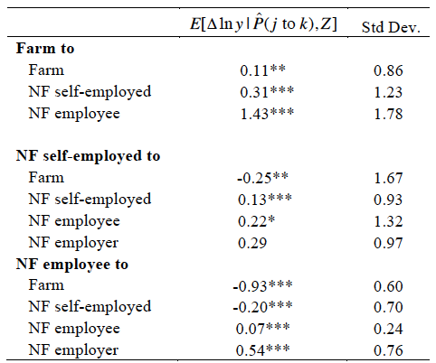
Estimations of log earnings change between 2005 and 2007, 2007 and 2010
Dubin-Mcfadden (1984) + Bourguignon et al. (2007) correction model:
Compared to initial occupation
Introduction & Motivation Data & Definitions Methods & Results Conclusion

Slide 24
Conclusions
Significant occupational transitions in rural Thailand, mainly involving moving to non-farm employment, rather than starting businesses that employ others.
Transitions into the RNFE are associated with statistically significant earnings gains while transitions into farming are causally associated with earnings losses.
The cumulative distribution of income shows that non-farm employers’earnings distribution stochastically dominates the other categories, signaling an occupational ladder: the best employment is as a RNFE business owner and employer; the worst is as an agricultural worker or farmer.
However, only a small number of individuals become non-farm employers, reflecting the difficulty involved in starting, expanding or even keeping a rural non-farm business.
Introduction & Motivation Data & Definitions Methods & Results Conclusion

Slide 25
Thank you for your interest and, especially, your comments
Photo credit: Dave Sperling, http://www.pbase.com/davesperling/image/77781234

